Slide 1

Policy Administration System
FSE – Business Aligned Project
Case Study
POD 1
Trainer : Shrivalli
Mentor : Ashok

Slide 2
Policy Administration System
Team
Shivangi
Ram Kumar
Sathvik
Vamshi
Vasavi
919045
918482
919766
919785
919758

Slide 3

Contents
Introduction
Tech Stack
Diagrams
Authorization Microservice
Consumer Microservice
Policy Microservice
Quote Microservice
Insureity Portal
Result and Screenshots
Challenges faced

Slide 4
Introduction
A leading Insurance Management Organization offers Business insurance that protects businesses from losses due to events that may occur during the normal course of business. There are many types of insurance it provides for businesses including coverage for property damage, legal liability and employee-related risks.
Companies evaluate their insurance needs based on potential risks, which can vary depending on the type of environment in which the company operates. Business insurance refers broadly to a class of insurance coverage intended for purchase by businesses rather than individuals.

Slide 5
Introduction
Quotes will get generated based on the consumer business and if the consumer is fine with the quote, then the policy will be issued. A quote is an estimate of premium for the insurance coverage you selected and information you entered.
In this project we focus only on the Business Property Insurance that covers building, equipment, signage, inventory, and furniture in the event of a fire, storm or theft.
Insureity is the Portal that allows any Agents to Login and create Policies for the consumers.
This Portal in turn interacts with the Middleware system of the Organization which will allow the Agents to create policies based on quotes.

Slide 6
Problem
Statement
The Insurance Organization operates over Insurance Agents to handle the Policy Subscription. An insurance agent is a licensed professional who sells an insurance company’s products to consumers for a commission. An agent helps consumers select the right insurance to buy, but represents the Insurance Organization in the transaction.

Slide 7
Tech Stack
Hardware Requirement
Developer Laptop with 8GB RAM​
Software Requirement
C#
.Net
Entity Framework Core 6
Angular 12
Bootstrap 4
Visual Studio 2019
Visual Studio Code
SQL Server 2018
Postman Client in Chrome
Azure Cloud access

Slide 8
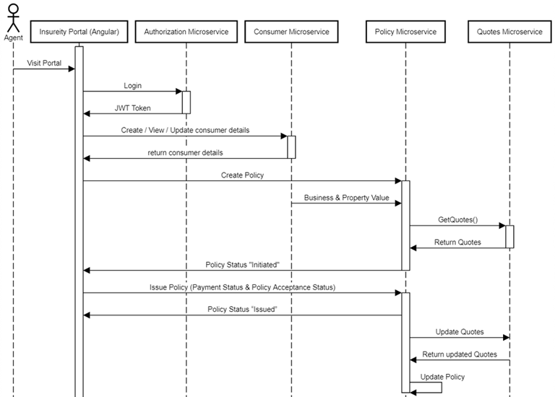
Sequence Diagram

Slide 9
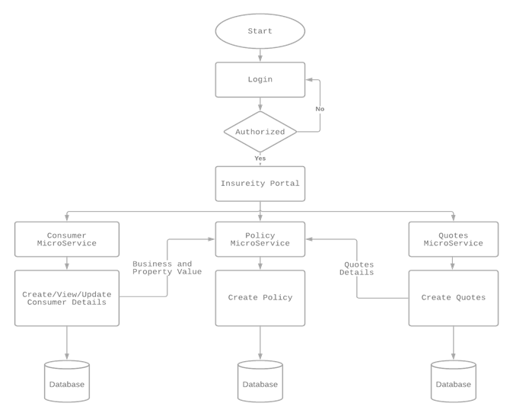
Flow Diagram

Slide 10
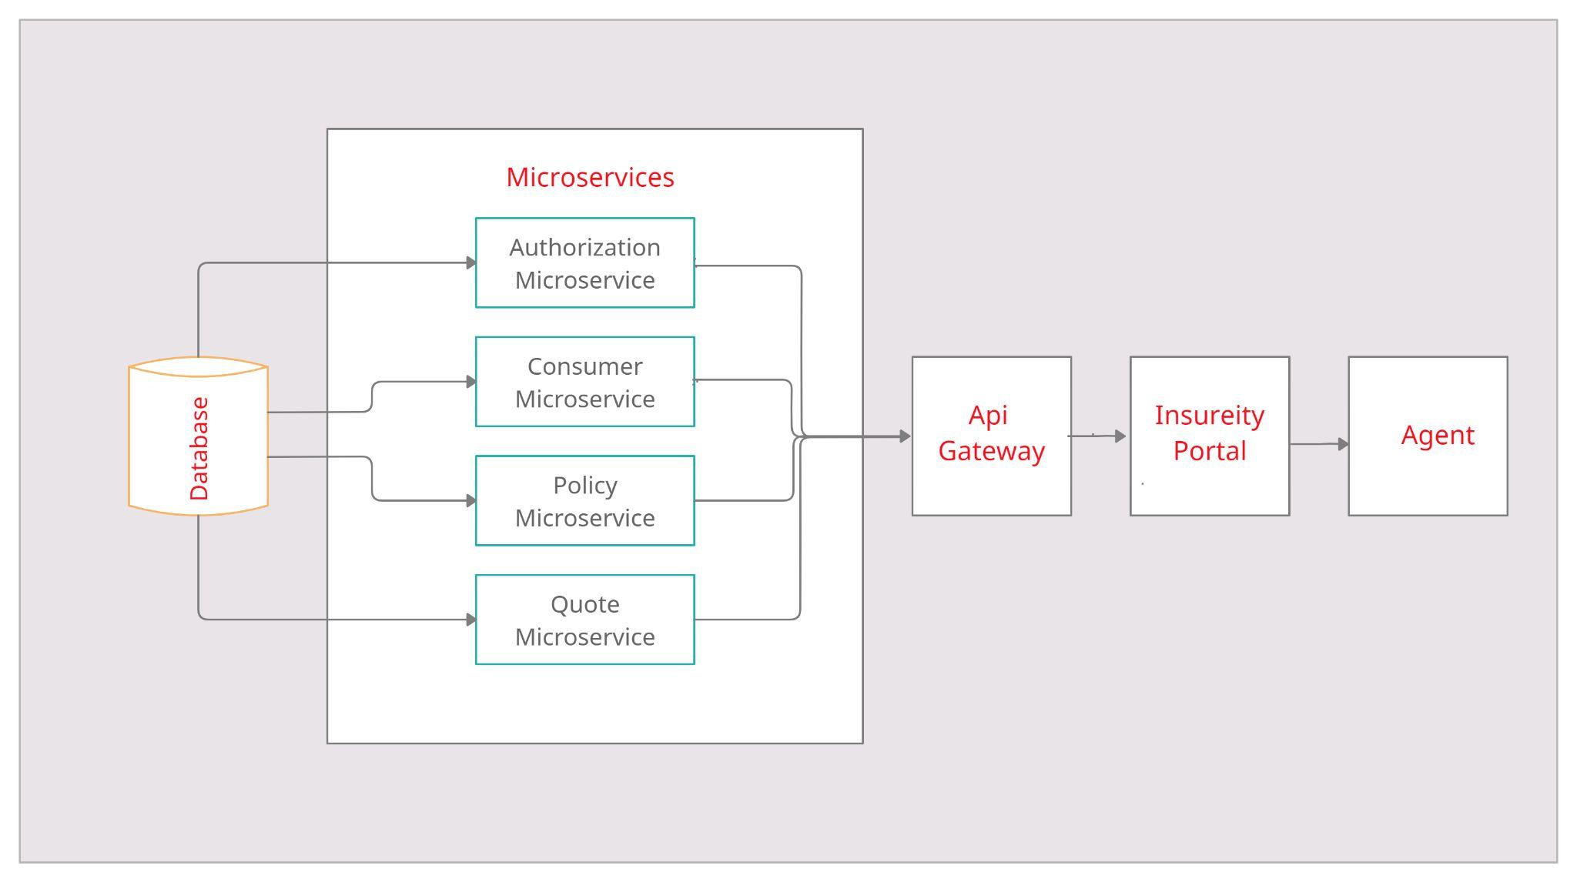
Architecture

Slide 11
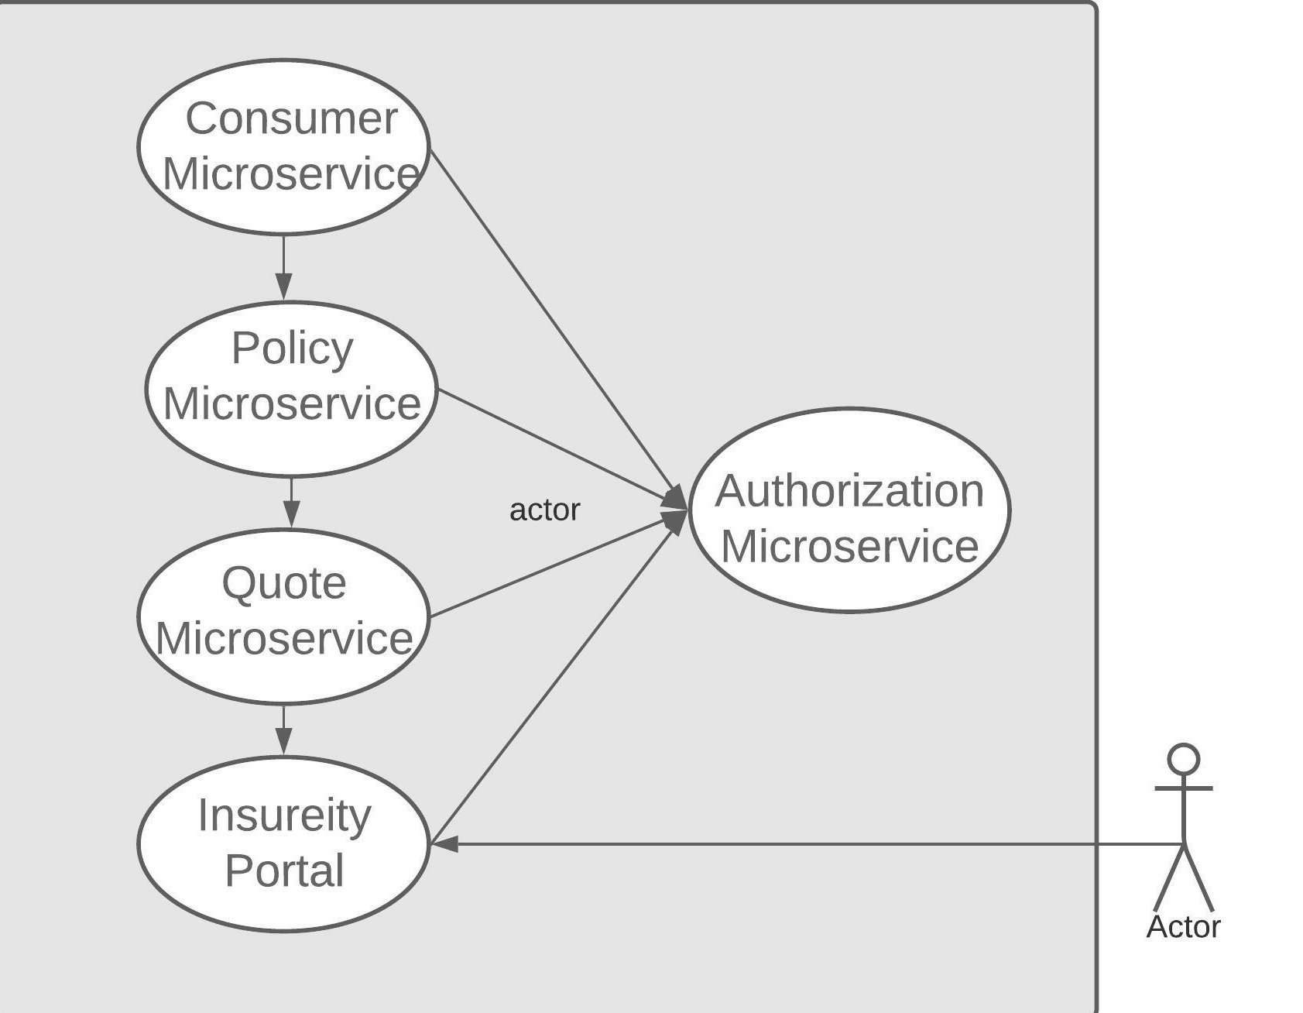
Use Case Diagram

Slide 12
Authorization Microservice
•Authorization module is the first module of Insureity Portal that will be used to check the validity of the Agent. That if the Agent who is trying to access the portal is valid or not. It uses JSON object to transfer data in a secure way between the parties.
•Here the data is transmitted using JWT between parties which are digitally signed so that it can be easily verified and trusted.

Slide 13
Authorization Microservice
Most common JWT flow works as follows:
•Firstly, a user will enter his/her credentials on the login page.
•Then those credentials will be send at the back-end for the validation and after validation is completed a token will be generated which will be sent back to the user.
•Token generated can be used to access the session until token time is expired.
•When the request is made by user for accessing the resources, the portal will validate the JWT and decides for the resources, and after that processes the request accordingly.

Slide 14
Authorization Microservice
RestEnd Points
POST: /Login (Input: User’s Credentials | Output: User will be logged in)

Slide 15
Consumer Microservice
Consumer Module is a part of Insureity Portal that acts a Middleware and has the following Entities.
Consumer
Business
Property
BusinessMaster
PropertyMaster

Slide 16
Consumer Microservice
Consumer (Get,Post,Put,Delete)
Consumer Name, Date of Birth , Pan Number, Email.
Business (Get,Post,Put,Delete)
Business Type, Total Employees , Consumer Id, Business Master ID.
Property (Get,Post,Put,Delete)
Building Type, Building Age, Business Id, Property Master ID.

Slide 17
Consumer Microservice
In Get-Consumer and Create-Consumer we can get all details of the consumer that has been created with the help of Create Consumer.
In Get-Business, we can get the details of the Business of the Consumer and in Create-Business, we can create a record for the business with the ConsumerId as reference.
In Get-Property, we can get the details of the Property of Business and Create a Property with reference to BusinessId which is referred to ConsumerId.

Slide 18
Consumer Microservice
RestEnd Points
POST: /createConsumerBusiness (Input: Consumer Details like name, business type, consumer DOB, email, PAN #, Business Turnover, Total Employees, Agent Details etc.. | Output: Status)
PUT /updateConsumerBusiness (Input: Consumer ID, Consumer Details like name, business type, consumer DOB, email, PAN #, Business Turnover, Total Employees etc.. | Output: Status)
POST: /createBusinessProperty (Input: Consumer ID, Property Type, Property Age, Storeys etc. | Output: Status)

Slide 19
Consumer Microservice
RestEnd Points
PUT: /updateBusinessProperty (Input: Consumer ID, Property ID, Property Type, Property Age, Storeys etc. | Output: Status)
GET: / viewConsumerBusiness (Input: Consumer ID) | Output: Consumer Details like name, business type, consumer DOB, email, PAN #, Business Turnover, Total Employees etc.)
GET: / viewConsumerProperty (Input: Consumer ID, Property ID) | Output: Property ID, Property Type, Property Age, Storeys etc.)

Slide 20
Policy Microservice
Policy Module is a Middleware Microservice that performs the following operations:
Create Policy
Issue Policy
View Policy

Slide 21
Policy Microservice
Creates Policy based on Business and Property Value from Consumer Microservice. For these values, the service will validate the permissible Policies and for the coverage, we fetch the quotes from Quotes service.
Issue Policy will issue a policy based on the payment status, for the quoted insurance cover.
View Policy allows to view the Policy Details.

Slide 22
Policy Microservice
RestEnd Points
POST: /createPolicy (Input: Property Id | Output: Policy Status)
PUT: /issuePolicy (Input: Policy ID, Payment Details | Output: Issue Status)
GET: / viewPolicyById (Input: Policy ID | Output: Policy Details)
GET: /getQuote (Input: Business Value, Property Value | Quotes details)

Slide 23
Quote Microservice
To issue the policy, we need the know the amount for which the policy should be issued. This is the very important part to issue the policy.
Quotes Microservice will be invoked only from Policy Service. Post authorization of request, based on the business value and property value, for the opted policy quotes will be calculated.

Slide 24
Quote Microservice
Ex.: If Business value is 0-2 AND Property Value is 0-2, and Property Type is “Equipment” then quotes can be 80,000 INR | If Business value is 3-5 AND Property Value is 3-5 and Property Type is “Equipment” then quotes can be 50,000 INR.
Note: Always the quotes are for the insurance period given in the Policy Table.

Slide 25
Quote Microservice
RestEnd Points
GET: /getQuotesForPolicy (Input: Policy, with all value ranges and type | Output Quotes)

Slide 26
Insureity Portal
Portal allows the Agents to Login. Once successfully logged in, the agent can do the following operations:
Create / Edit / View Consumer, Businesses and Properties
Create Policy
Issue Policy – Based on Payment Information, policy will be issued.
View Policy.
Get Quote.
Each of the above operations will reach out to the middleware Microservices that are hosted in cloud.

Slide 27
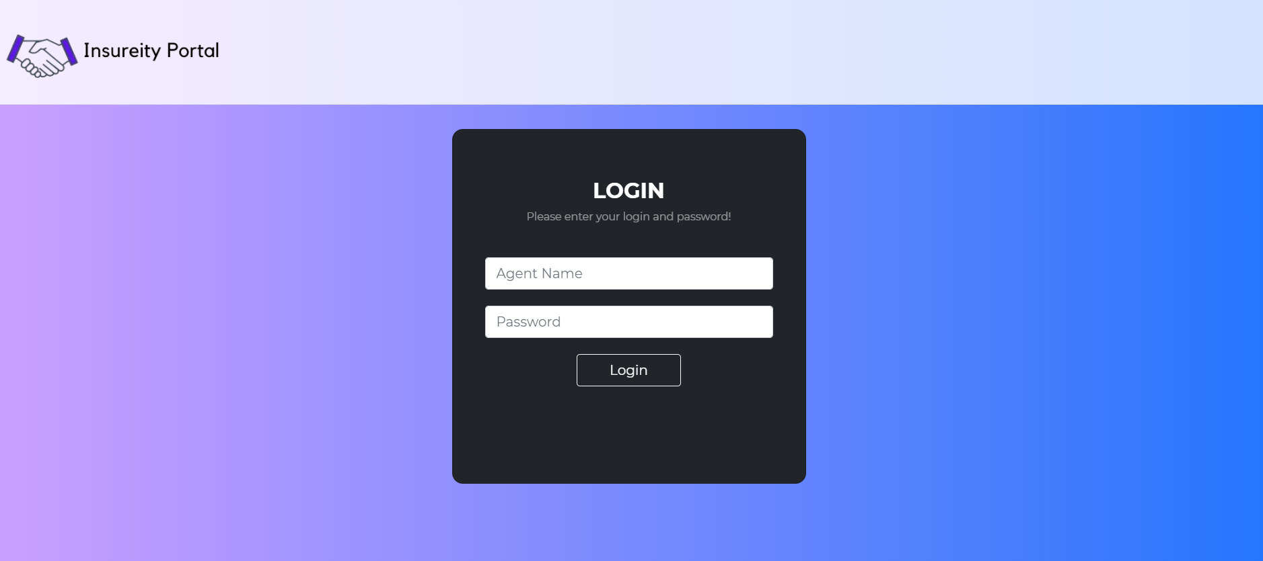
Screenshots
Login Page

Slide 28
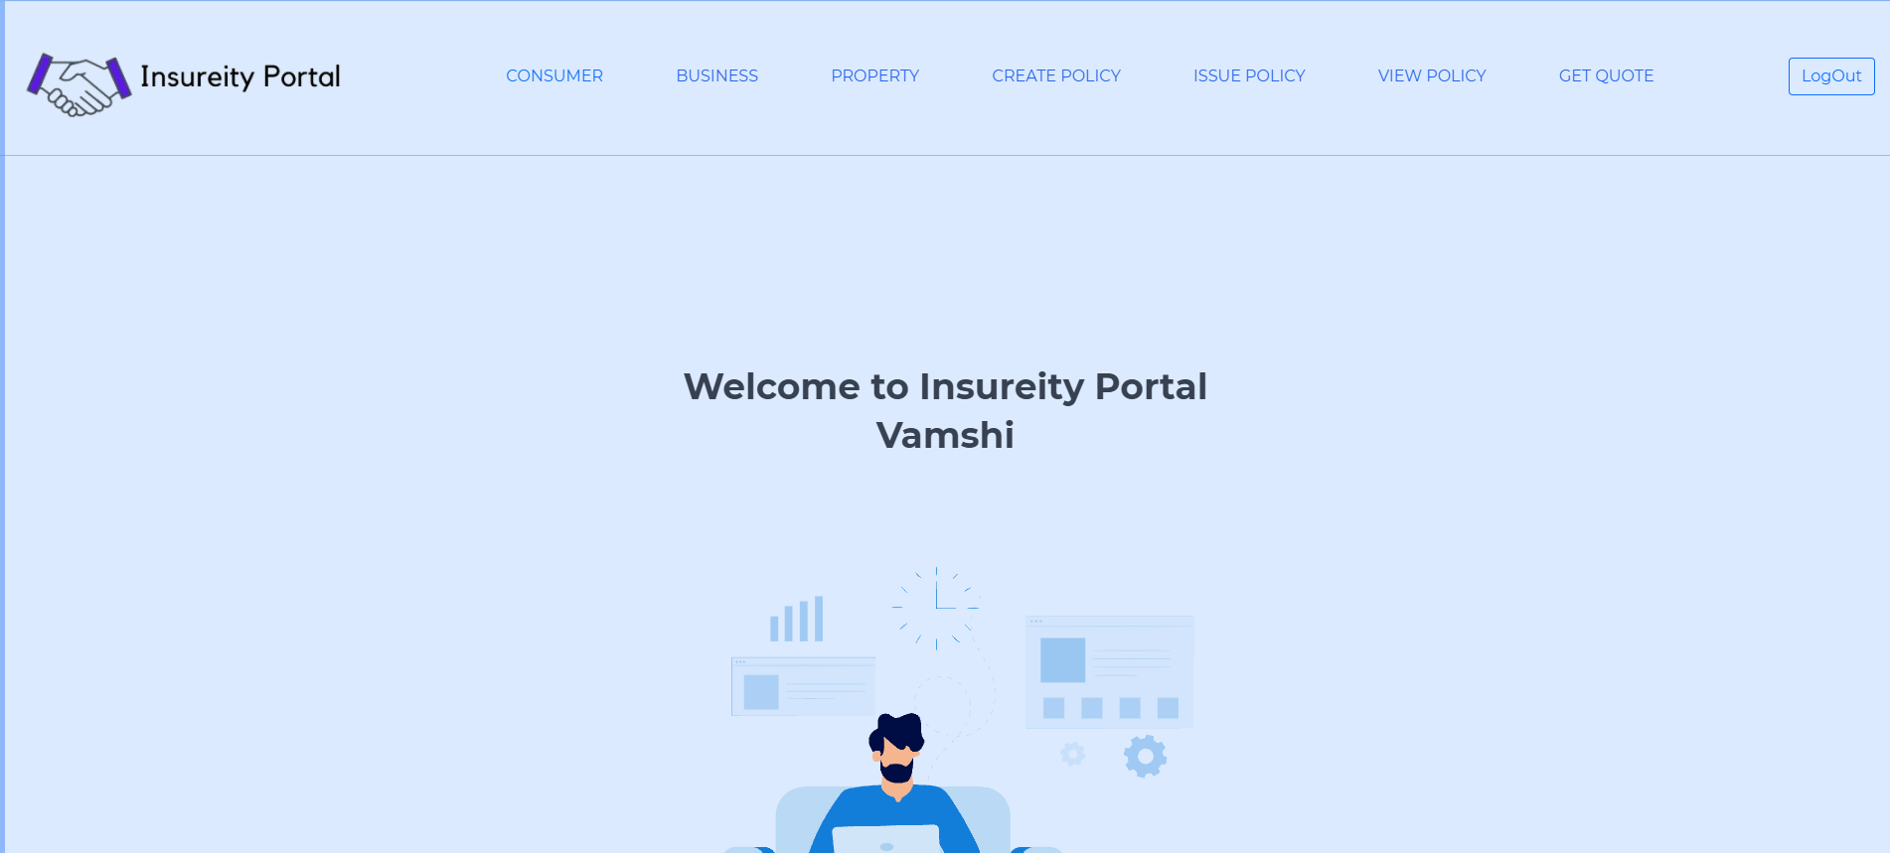
Screenshots
Landing Page

Slide 29
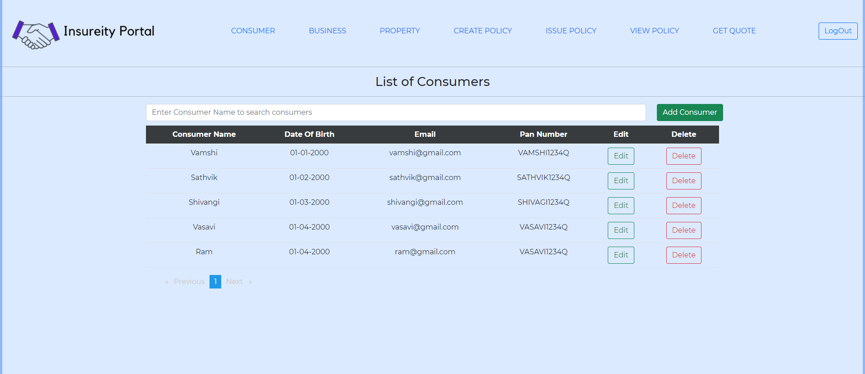
Screenshots
Consumer Page

Slide 30
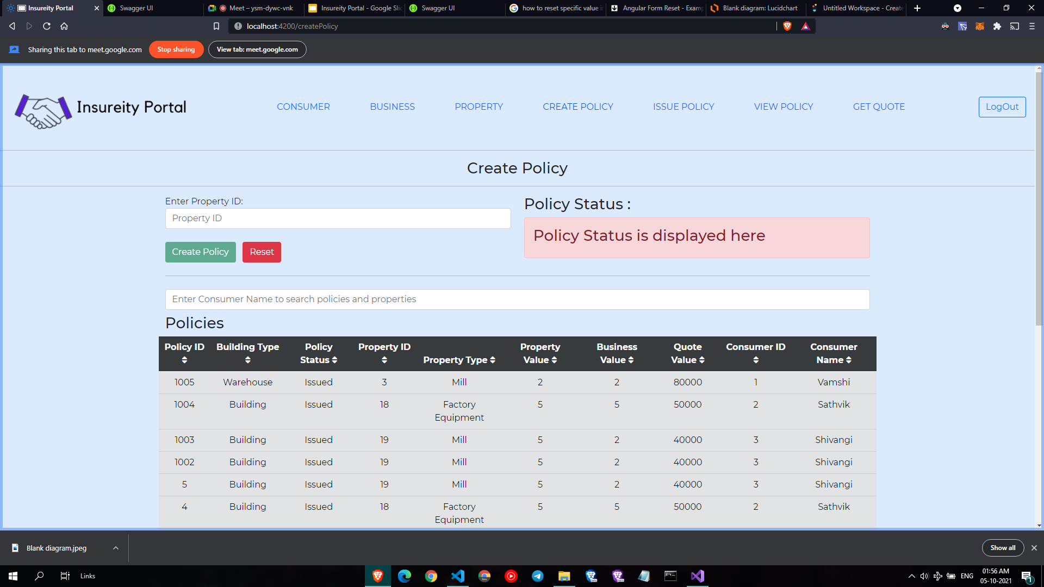
Screenshots
Policy Page

Slide 31
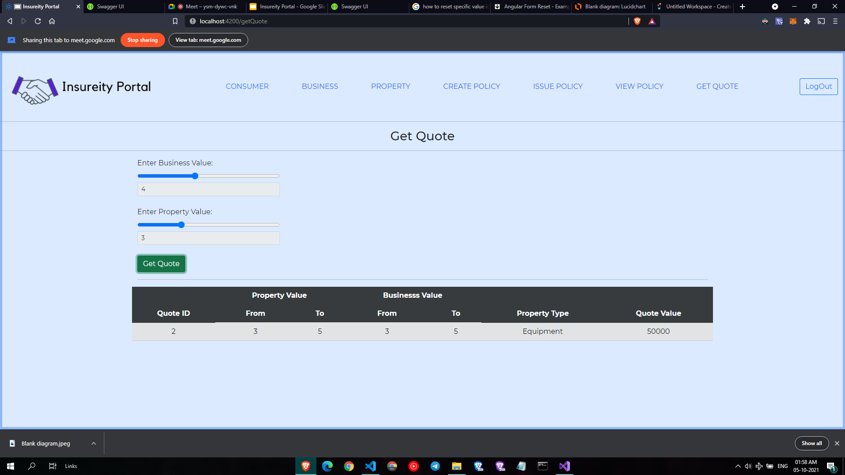
Screenshots
Quote Page

Slide 32
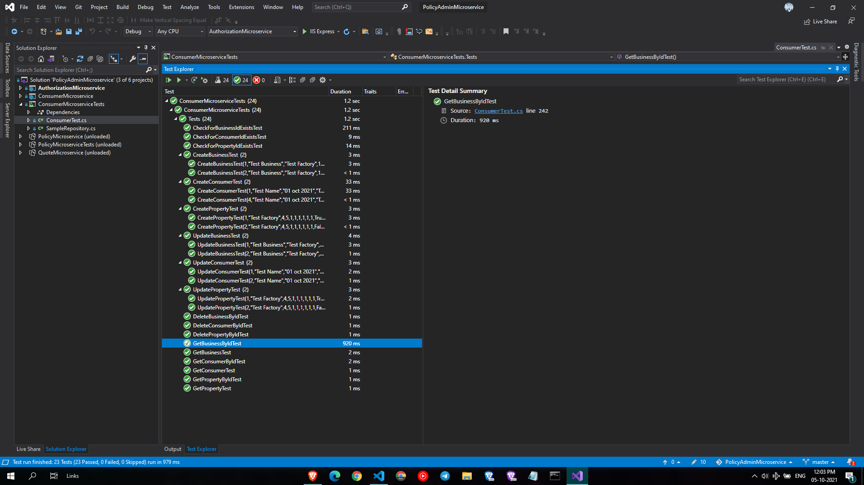
Screenshots
Unit Testing

Slide 33
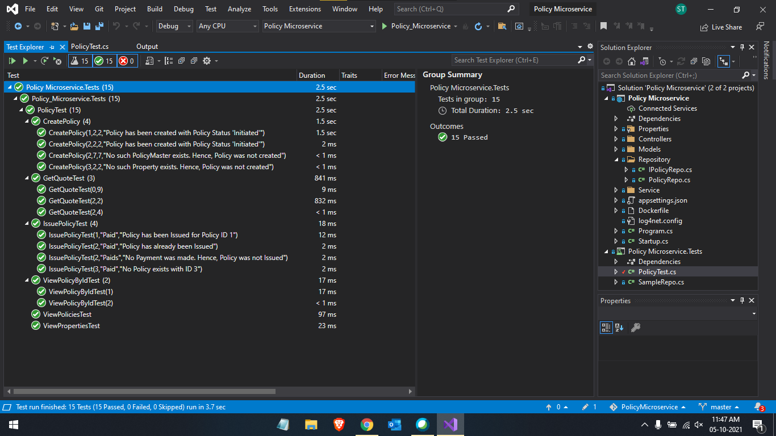
Screenshots
Unit Testing

Slide 34
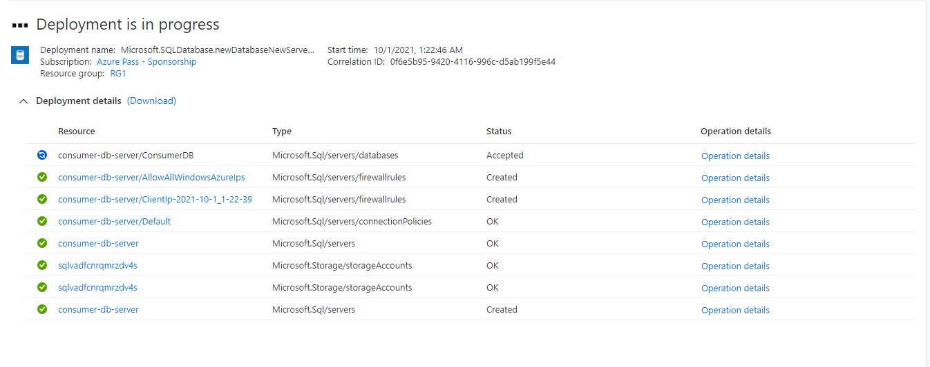
Screenshots
Deployment

Slide 35
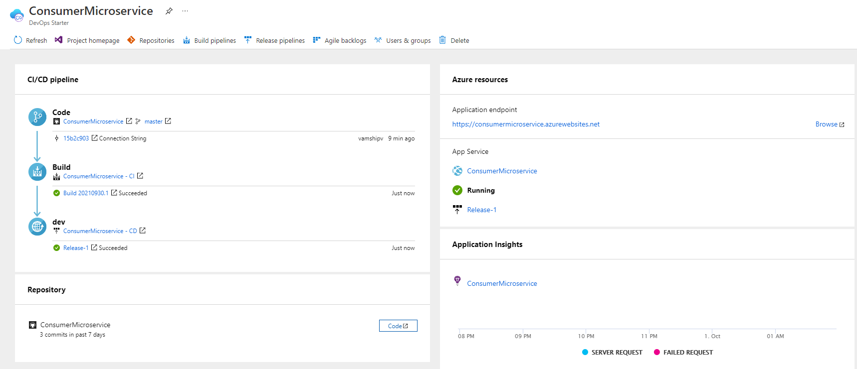
Screenshots
Deployment

Slide 36
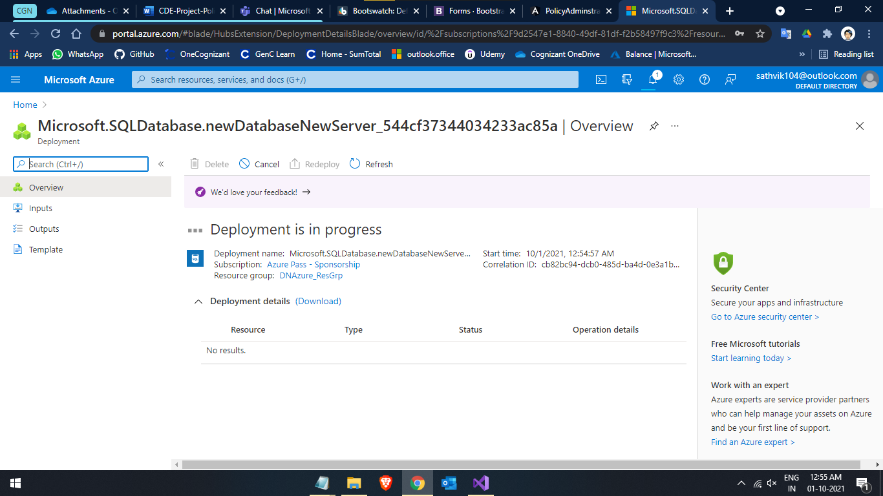
Screenshots
Deployment

Slide 37
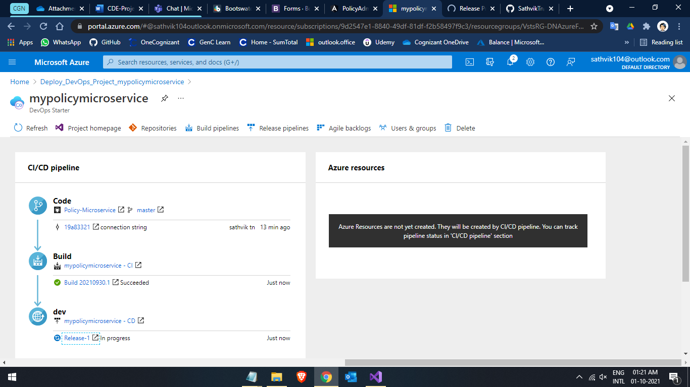
Screenshots
Deployment

Slide 38
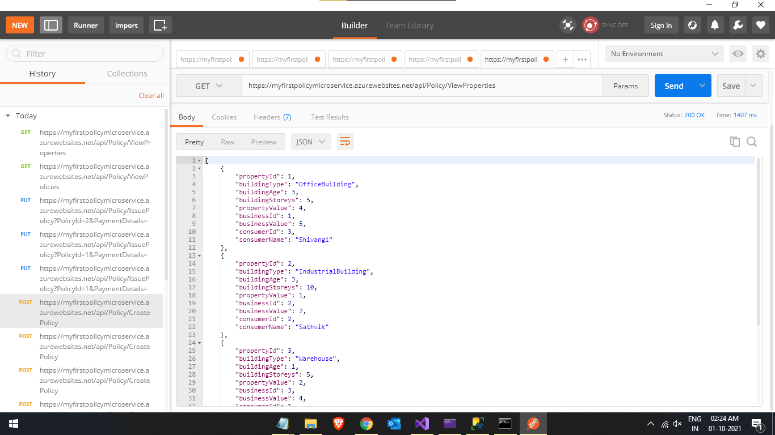
Screenshots
Deployment

Slide 39
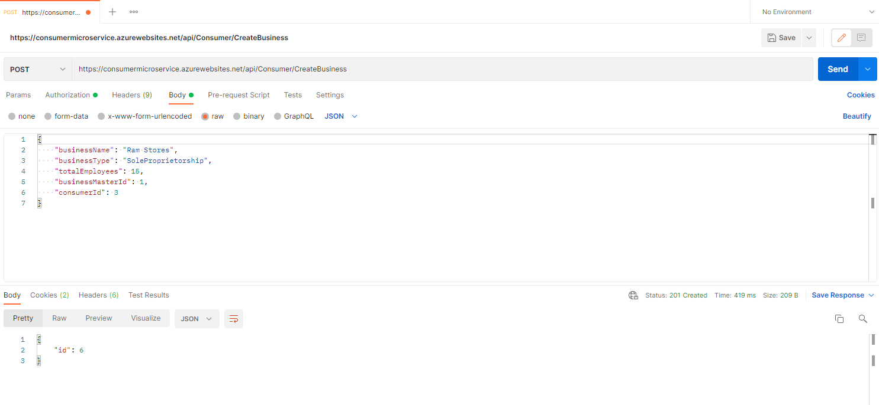
Screenshots
Deployment

Slide 40
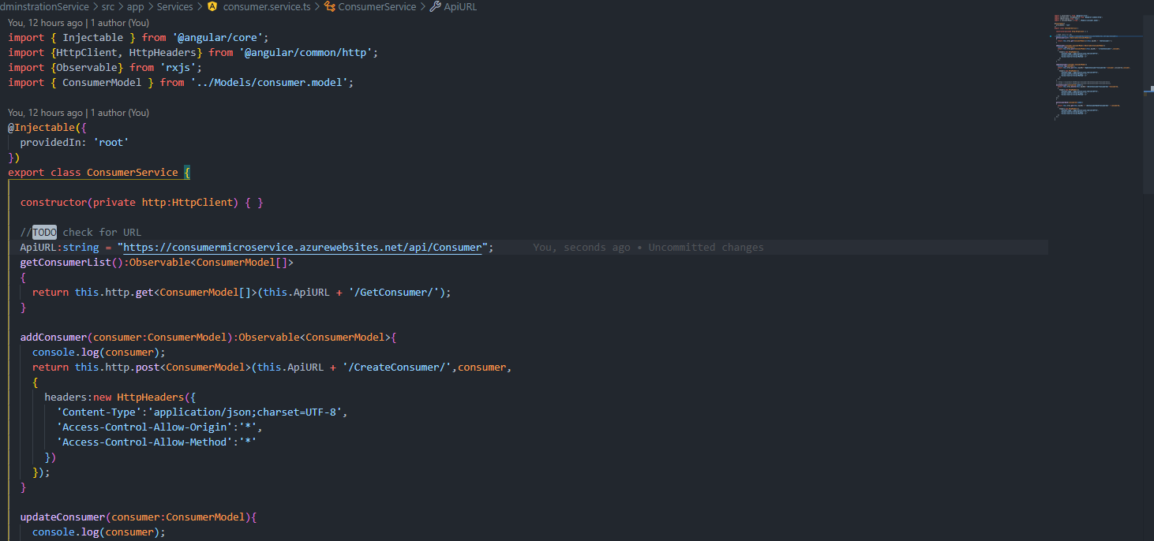
Screenshots
Deployment

Slide 41
Challenges Faced
Working with Angular.
Data Communication between Angular Components.
Applying Bootstrap to Angular.
Working with Authorization and Auth-Guard.
Cloud Deployment.

Slide 42
Thank You

